Slide 1
Class -4 loop part-2 advanced feathers
Mostafizur Rahman Nayeem
Cse, batch – 23

Slide 2
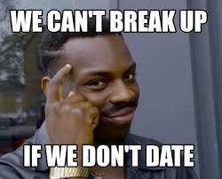
Agenda
Topics Covered:
Break
continue
goto, and Labels
Nested Loops
Practice Problems

Slide 3
We can control loops using:
break
→ Exits the loop immediately.
continue
→ Skips the current iteration and moves the next one.
goto and Labels
→ Jump to a specific part of the program.
Nested loops
→ help in solving complex problems like pattern printing, matrix operations, etc.

Slide 4
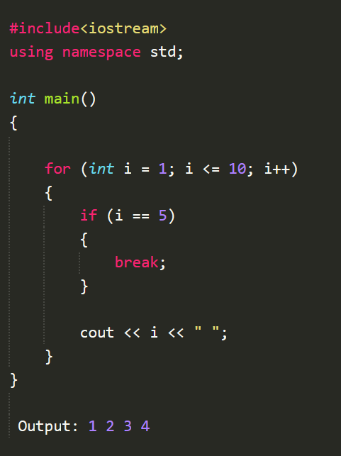
break :
The 'break' Statement
Definition: Terminates the loop immediately.
Usage: Exits a loop when a specific condition is met.
Example:

Slide 5
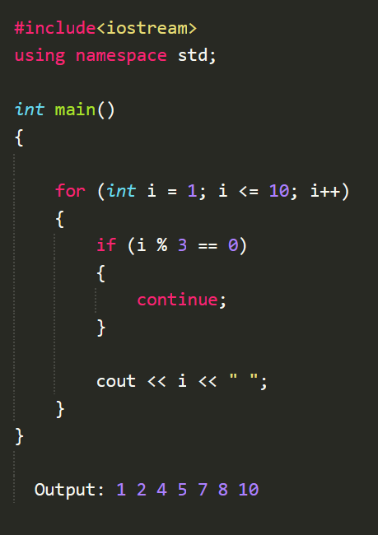
Continue :
Definition: Skips the current iteration and proceeds to the next.
Usage: Ignore specific cases within loops.

Slide 6
'goto’ Statement and Labels
Definition:
Transfers control to another part of the program marked by a label.
Syntax:
goto label_name;
// Code skipped
label_name:
// Target code

Slide 7
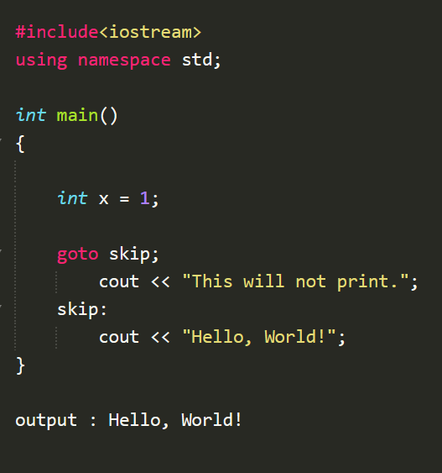

Slide 8
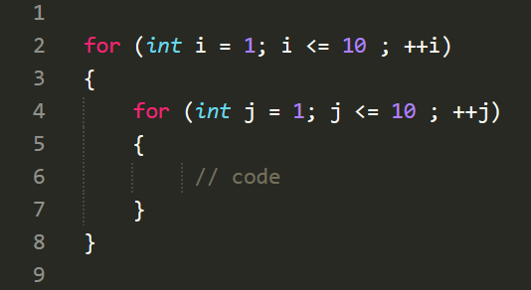
Nested Loops
Definition: A loop inside another loop.
Usage: Used in matrix operations, pattern printing, etc.
Syntex:

Slide 9
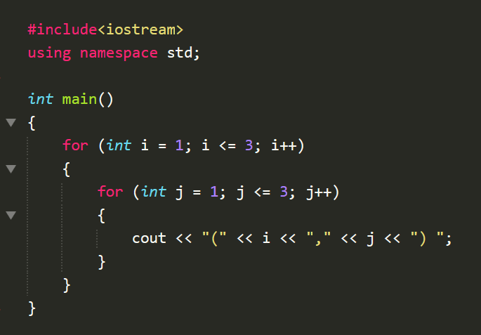
output :
(1,1) (1,2) (1,3) (2,1) (2,2) (2,3) (3,1) (3,2) (3,3)

Slide 10
problems

Slide 11
q1.
Write a program that skip the numbers that are divisible by
3 or 5 , and print the other numbers up to 50.
Output :
1 2 4 7 8 11 13 14 16 17 19 …………..

Slide 12
Q2.
Write a password attempt system that justify your password is right and wrong
Example :
Pass = 1234
5467 wrong password
8267 wrong password
………………………………
1234 password match.

Slide 13
q3.
Write a program that find the first negative number and print its position ?
input:
2 7 4 9 8 -3 8 2 3 -4
Output :
-3 6

Slide 14
q4.
you are given 4x4 matrix,
Write a program that find the first three negative number and print its position ?
input:
1 7 9 13
6 2 -3 9
7 -1 5 1
-9 3 7 -8
Output :
(2 3) = -3
(3,2) = -1
(4,1) = -9

Slide 15
q5.
Codeforces problem : 577 A (MEDIUM)
MULTIPLICATION TABLE
https://codeforces.com/contest/577/problem/A

Slide 16
tHANK YOU everyone

